Slide 1
ANIMAL-MAN AND HUMAN MAN
MAN
ANIMAL-MAN AND HUMAN MAN
MAN

Slide 2

sexual permissiveness
The concept of marriage and family is not there among the animals.
They randomly mate to produce their offspring.
After the mother stops suckling her young ones, she loses all relationship with her issue.
Among domestic animals, the male plays little part in the life of the new generation fathered by him.

Slide 3
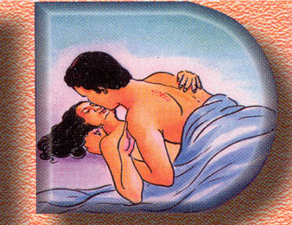
The attention was drawn to the permissiveness being adopted by some youth in their pre-marital sexual relationship and often with more than one person.
It was regarded to be immoral behavior, which degraded cultured human beings to uncultured-‘animals’.

Slide 4
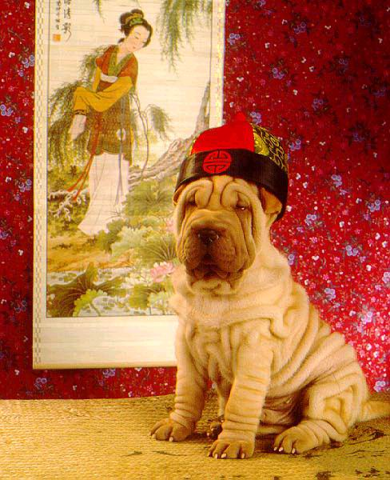
"An animal, even if clothed will behave as an animal.
A human being will continue to be the same even if the person is not dressed.
However, irrespective of the legal aspect, an unclothed person will not be regarded as a cultured human being.

Slide 5

scanty-dress culture
The scanty-dress culture being adopted by some youth has misled many young people.
It lowers the image and grace of a cultured human being.
It may be an important cause of immorality among the youth.
Sikh youth must avoid it to maintain their dignity and self-esteem.
It is uncivilized behavior to go out to a public place baring one's body.

Slide 6
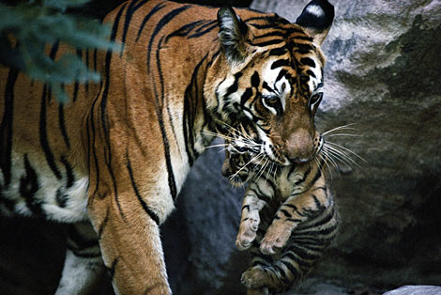
It was observed that human beings are the most intelligent animals.
Further, he has discovered many secrets of nature and has made many inventions – engine, airplane, telephone, computer, etc.
Man has brought every animal, even the most ferocious and dangerous ones, under his control.

Slide 7
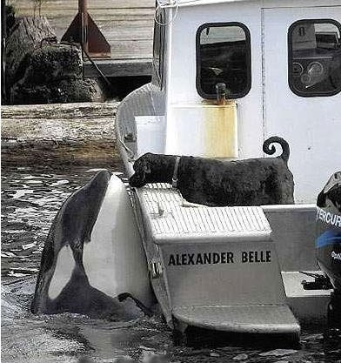
It was also agreed that human beings (without technology) have their own limitations – the best engineer cannot build a weaver bird's nest.
Further, a gorilla can be tamed to type messages and communicate with human beings.
Human beings cannot communicate over long distance as dolphins can.

Slide 8
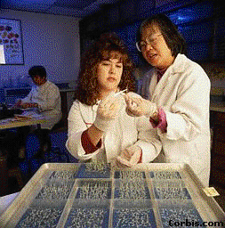
If we humans live only to eat, grow, produce children, get old, and die, we are absolutely no different from animals.
All living beings go through the same cycle during their life.
Education does not merely involve learning how to earn money,
we must also know the purpose of life and how to achieve it.
Going to school and becoming a professional does not make an ‘animal’-man into a ‘human’-man.

Slide 9
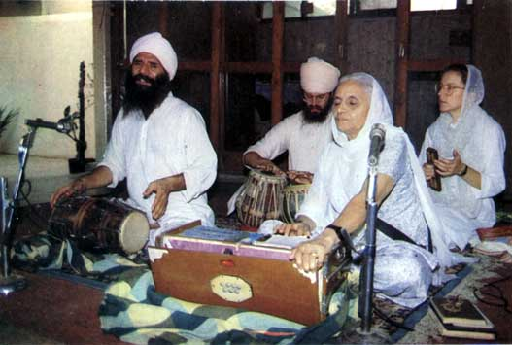
uniqueness of humans
Real uniqueness of humans lies in the fact that we can understand we have a mission in life and this faculty puts human beings in a distinct category of superior 'animals'.
It is, therefore, only the practice of faith (the mission of a human being) that raises an animal-man to the status of a human-man.

Slide 10

DESTINATION IS THE SAME, MERGING WITH *WAHEGURU*

Slide 11
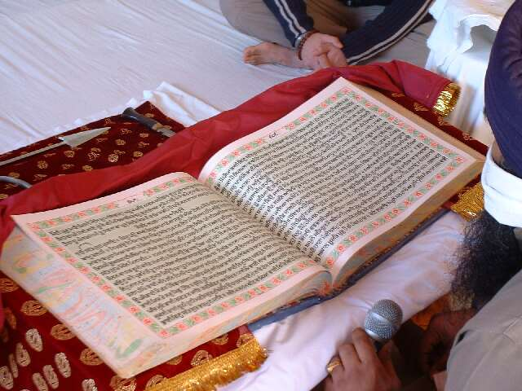
it is not possible for us to know why God created us.
We have to look somewhere else for an acceptable answer.
We need some enlightened God-person to explain to us the purpose of human life.

Slide 12
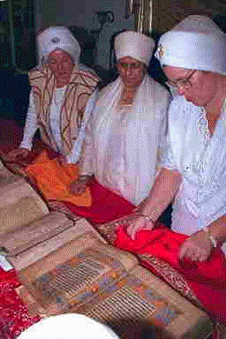
We can choose to believe any one of them.
That becomes our faith or religion, and whatever faith we choose, we have to live according to it.
Ignoring our faith means refusing to be a human being, and living the life of an ‘animal’-man.

Slide 13

True peace and pleasure is obtained by disciplining one’s mind and living according to one's faith.
Rejecting, or distorting the principles of faith, and living according to one's convenience only keeps one in an illusion.

Slide 14
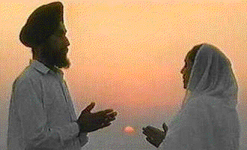
Doing exercise is not tormenting your body, but making it strong, healthy, and happy.
Forcing your mind to follow your faith is not limiting or restricting your happiness, but enjoying the path of real pleasure.

Slide 15
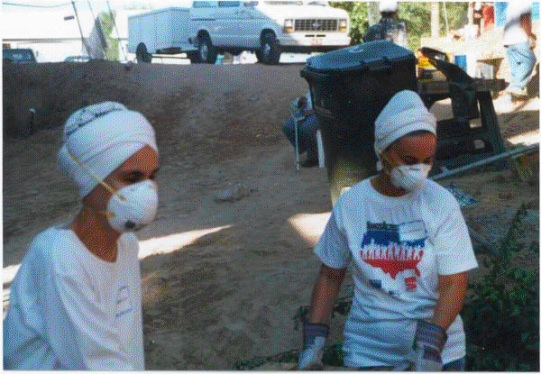
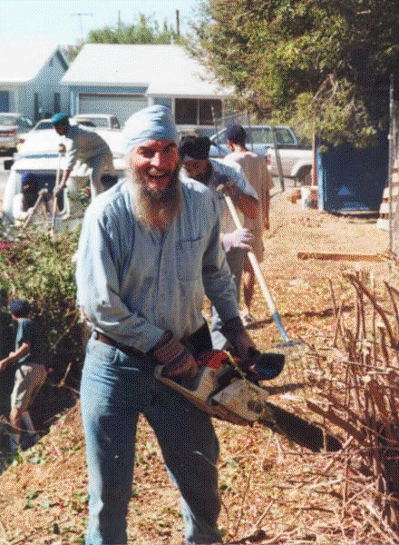
True SEVA from the heart….removes ego….
Faith tells us to practice the virtues – truth, service, and humility – and at the same time to stay away from vices – ego, lust, greed, and anger.
If one follows this path, one leads a peaceful and contented life here, and is also assured of a similar 'life' in the next world.

Slide 16
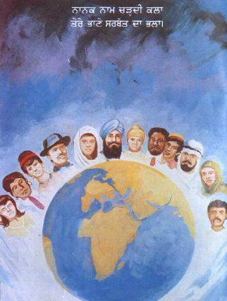
Mission of life
"
To understand and realize the Creator, Our Father, so that I am able to accept the whole of humanity as my brothers and sisters."

